Slide 1
MALDABA Clients-Management-PHP-MYSQL

Slide 2
HELLO!
I am Ashraful Alam
I am here because I love to give presentations.
You can find me at github/alam24

Slide 3
MALDABA Clients Systems
Clients Features
Login
Signup
Change Password
Edit Profile
Feedback
View Messages
Notification
Task: 1
Capture information about new clients (manual input)
Title
First Name
Surname
Date of Birth
E-mail
Mobile Phone
Address (in a format that is useable for future postcode look-ups and mail merges).

Slide 4
Task 1
1
Allow users to review new clients, and choose to either accept or reject them.

Slide 5
Task2
1
Allow users to review new clients, and choose to either accept or reject them.

Slide 6
Maldaba Clients Systems
TASK 2: Allow users to review new clients, and choose to either accept or reject them.
Admin Dashboard
Signup
Referred Clients
Accepted Clients
Rejected Clients
Notification of new User
View Deleted Users
Download User Excel File
Upload Json data to import 50000 data from existing system

Slide 7
Maldaba Clients Systems
TASK 1: Capture Clients Details
Title
First Name
Surname
Date of Birth
E-mail
Mobile Phone
Address

Slide 8
Task3
1
Let users see 3 lists:
Referred Clients
Accepted Clients
Rejected Clients

Slide 9
Task 4
1
Import 50,000 clients from existing system
to the new system will need to

Slide 10
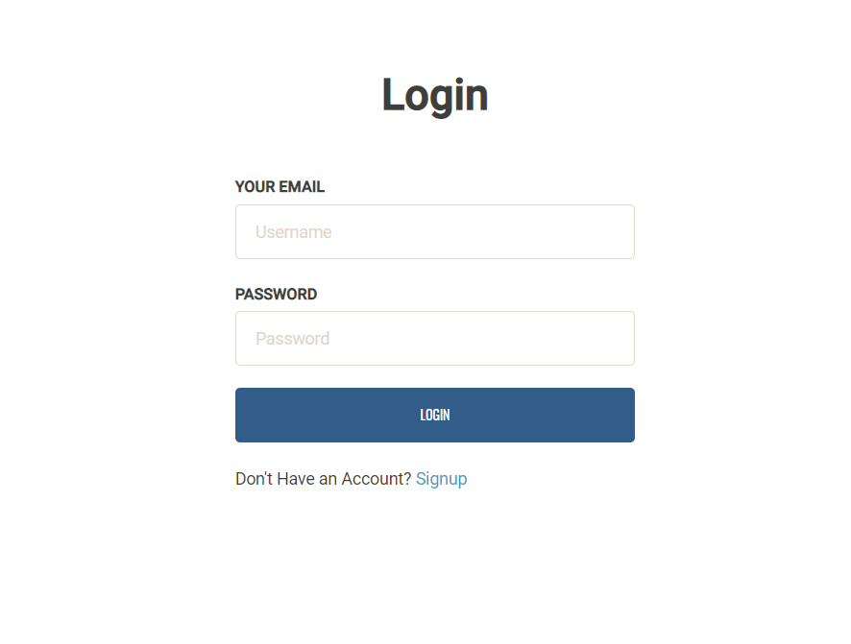
Maldaba Clients Systems
A complex idea can be conveyed with just a single still image, namely making it possible to absorb large amounts of data quickly.
Notes:
Client’s login Screen

Slide 11
Maldaba Clients Systems
A complex idea can be conveyed with just a single still image, namely making it possible to absorb large amounts of data quickly.
Notes:
Admin Panel

Slide 12
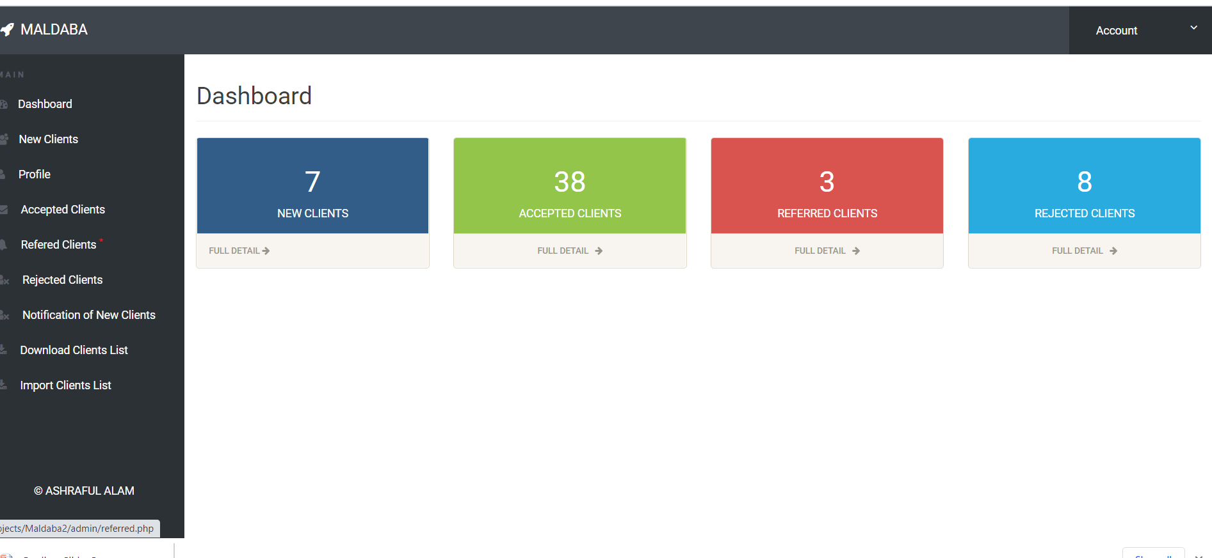
Maldaba Clients Systems
Notes:
Task 1 : Review New Clients, Accepted Clients, Referred Cleints, Rejected Clients

Slide 13
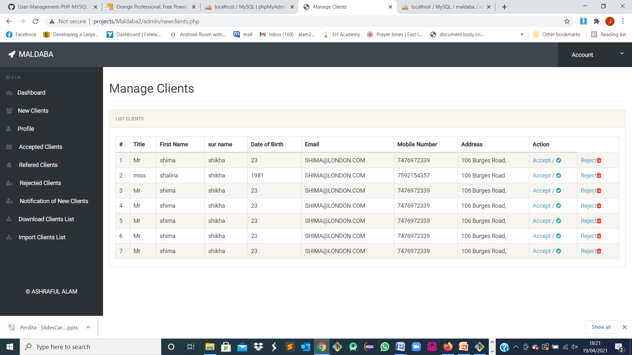
Maldaba Clients Systems
Notes:
Record of new Clients with Accept / Reject

Slide 14
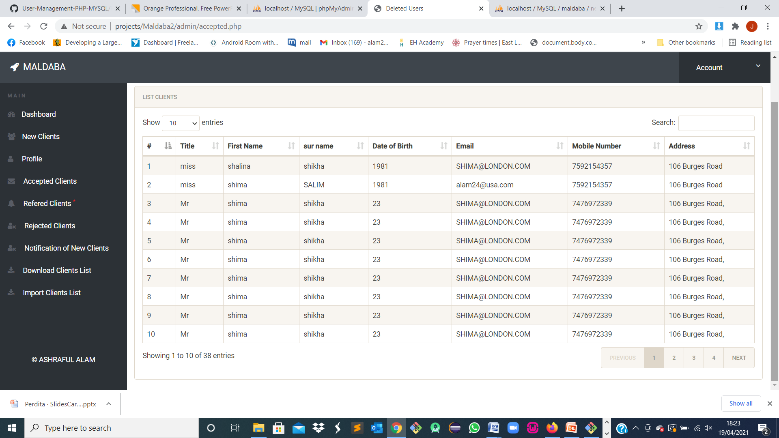
Maldaba Clients Systems
Notes:
Record of Accepted Clients

Slide 15
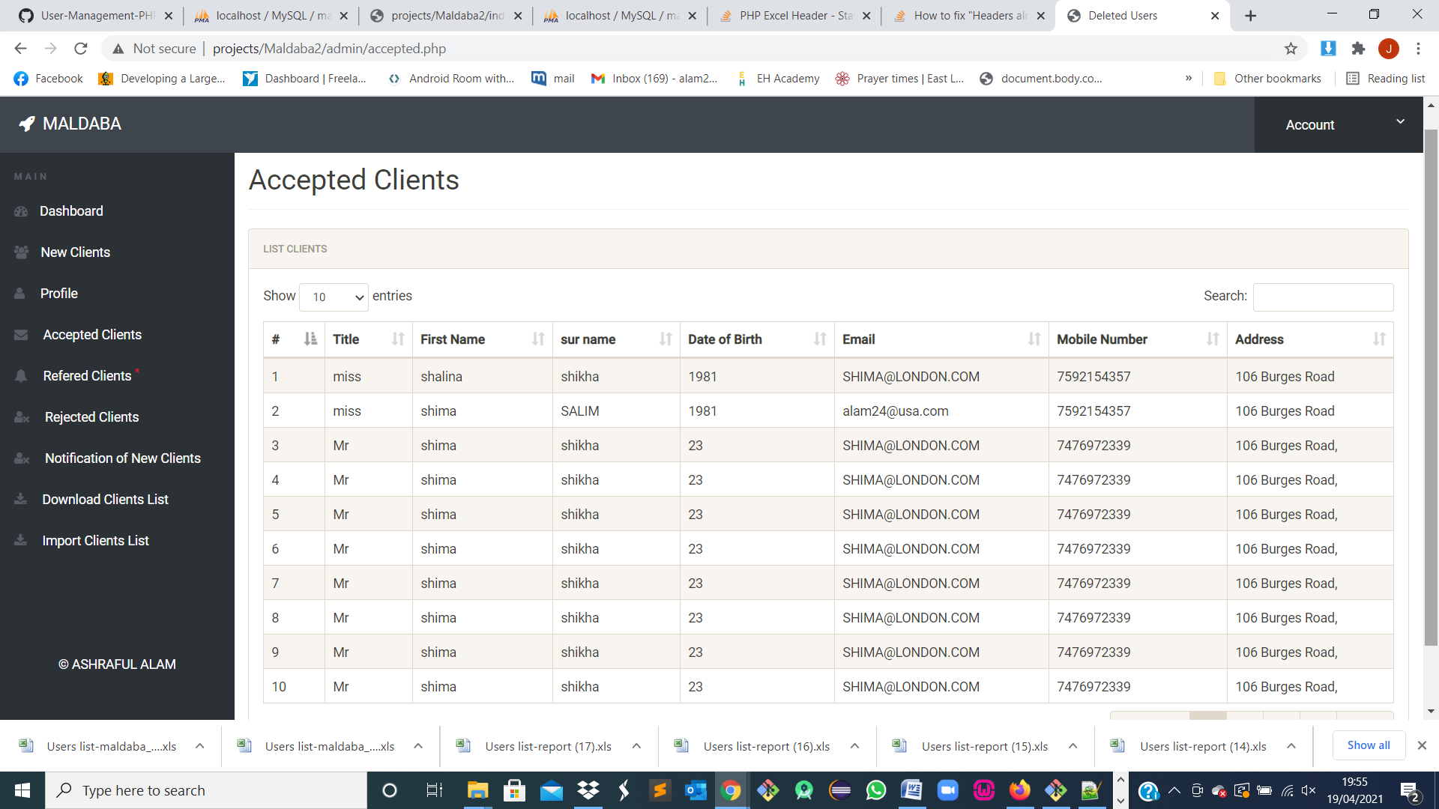
Maldaba Clients Systems
Notes:
Record of Accepted Clients

Slide 16
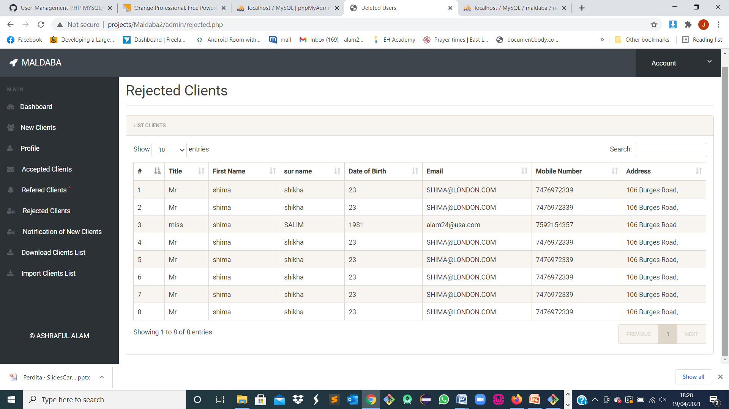
Maldaba Clients Systems
Notes:
Record of Rejected Clients

Slide 17
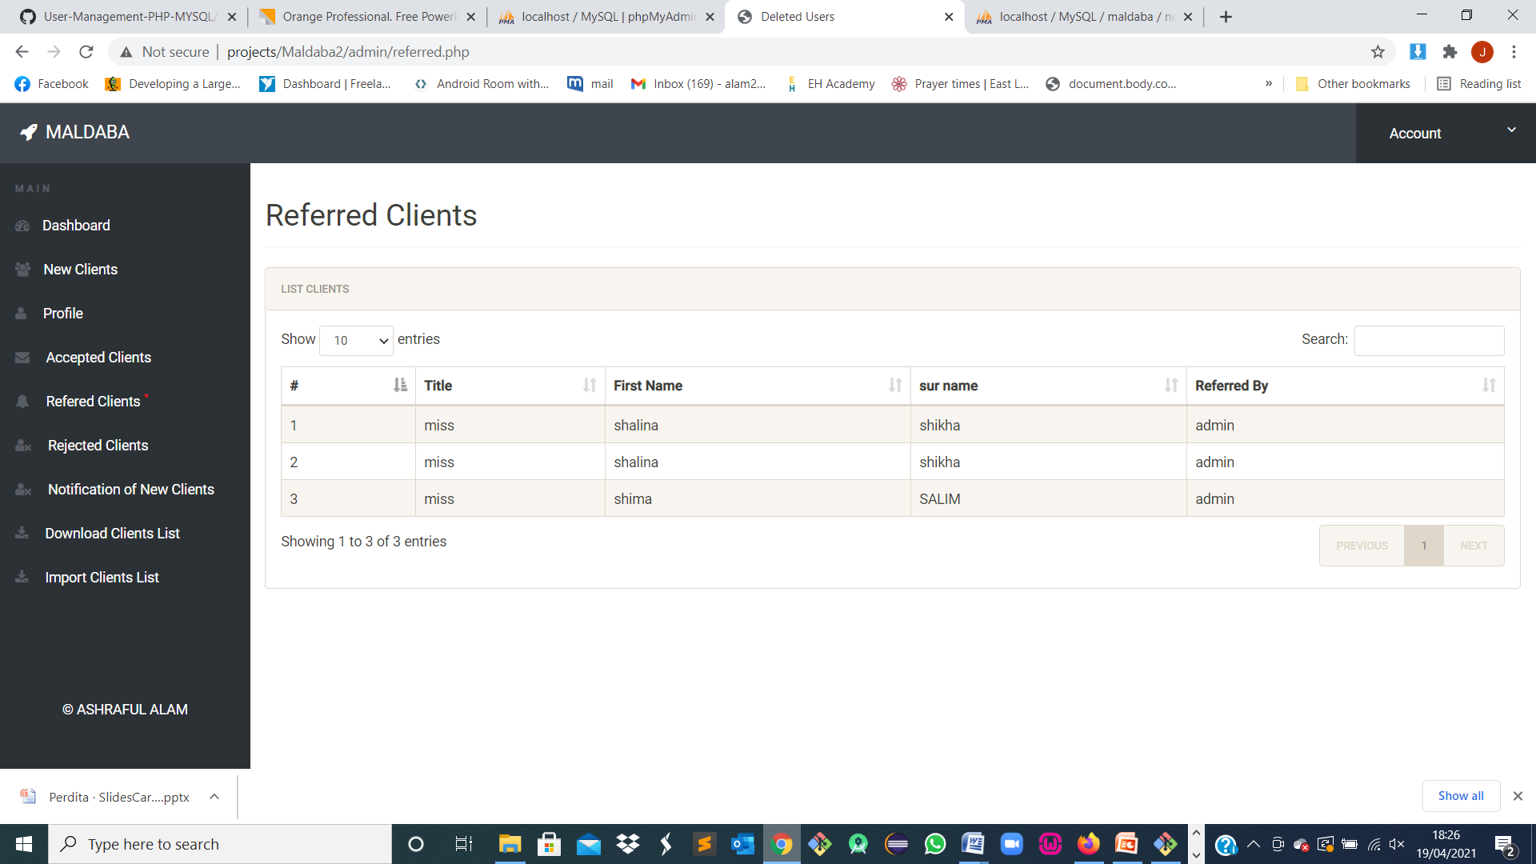
Maldaba Clients Systems
Notes:
Record of Referred Clients

Slide 18
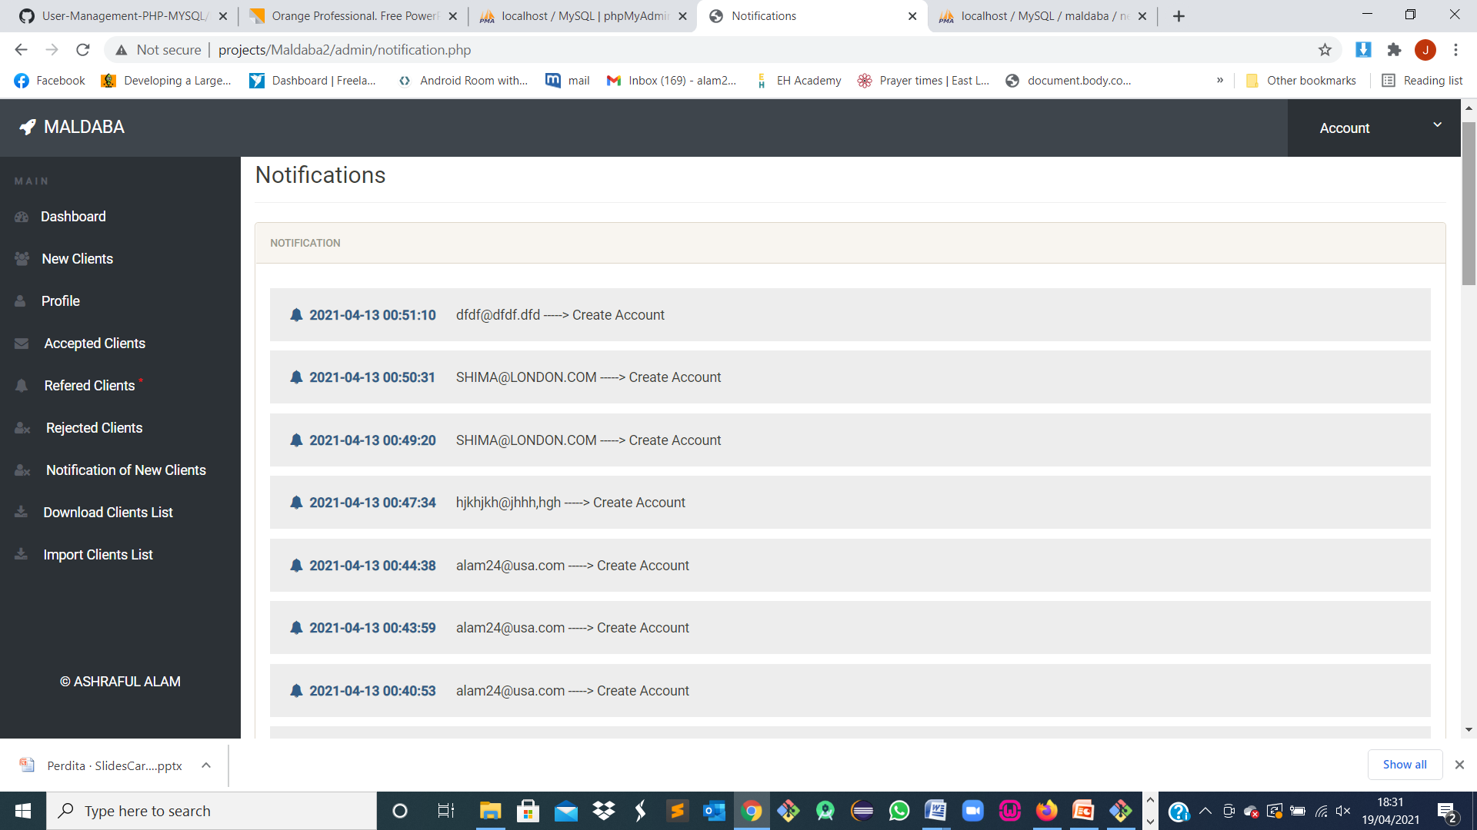
Maldaba Clients Systems
Notes:
Notification to Admin about new Clients

Slide 19
Thank you very much Have a nice day

